Slide 1

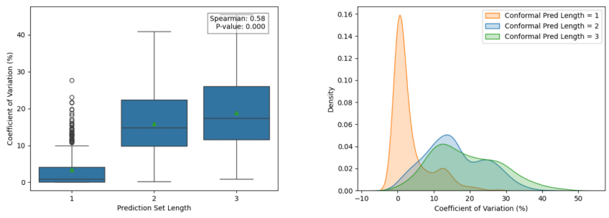

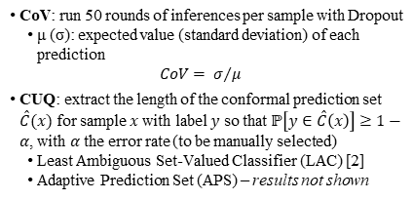
Conformal Prediction and Monte Carlo Inference for Addressing Uncertainty in Cervical Cancer Screening
Christopher Clark, MS, Scott Kinder, MS, Advaith Veturi, MS, Steve McNamara, OD, Benjamin Bearce, MS,
Praveer Singh, PhD, Jayashree Kalpathy-Cramer, PhD
Ophthalmology, University of Colorado Anschutz School of Medicine, Aurora, CO
Purpose
Experiments
Results: Task 2
Deep Learning approaches suffer from a lack of a native uncertainty metric
Uncertainty is important in the medical domain, where misdiagnoses have important consequences
Goal: to compare two methods of uncertainty quantification
Coefficient of Variation of Monte-Carlo Inference (CoV) [1]
Conformal Uncertainty Quantification (CUQ) to an ongoing cervical cancer screening project PAVE to determine the relationship between uncertainty and performance. [2]
Dataset: 17,013 cervical images from 9,462 women from 5 studies across Costa Rica, the US, the Netherlands
3 classes: normal, gray-zone, precancer+
Model: DenseNet121
Task 1: Relationship between conformal set length and type of prediction (correct, incorrect, single-, and double-class misclassification)
Task 2: Correlation between CoV and CUQ
Results: Task 1
Prediction | Set Length | P-value < .05
Correct | 1.78 | (ref.)
Incorrect | 2.38 | *
Single-class | 2.43 | * | (ref.)
Double-class | 1.93 | × | *
Conclusions
Task 1:
When the model is incorrect, it is more uncertain
Gray-zone class associated with more uncertainty when the model is correct
Task 2:
Statistically significant correlation between CoV and CUQ
Methods
CoV: run 50 rounds of inferences per sample with Dropout
μ (σ): expected value (standard deviation) of each prediction
$$CoV= σ/μ$$
CUQ: extract the length of the conformal prediction set $\hat{C}(x)$ for sample $x$ with label $y$ so that $ℙ\left[y∈\hat{C}\left(x\right)\right]≥1−α$, with $α$ the error rate (to be manually selected)
Least Ambiguous Set-Valued Classifier (LAC) [2]
Adaptive Prediction Set (APS) – results not shown
Ground Truth | Set Length Correct | Set Length Incorrect | P-value < .05
Normal | 1.58 | 2.54 | *
Gray-zone | 2.39 | 1.90 | *
Precancer+ | 1.88 | 2.31 | *
References
Gal, Yarin, and Zoubin Ghahramani. "Dropout as a bayesian approximation: Representing model uncertainty in deep learning." international conference on machine learning. PMLR, 2016.
Angelopoulos, Anastasios N., and Stephen Bates. "A gentle introduction to conformal prediction and distribution-free uncertainty quantification." arXiv preprint arXiv:2107.07511 (2021).

